Slide 1
Achieving International Consensus for the Prevention of Orthopaedic Wound Blistering; Results of a Delphi Survey
Dr Karen Ousey, Dr. Warren Gillibrand, Dr. John Stephenson
University of Huddersfield

Slide 2
Acknowledgments
Thanks to Molnlycke Healthcare for providing a non restrictive educational grant
All respondents to the Delphi

Slide 3
Effects of Blistering
In patient stays in hospital could be lengthened
Costs increase
Risk of infection
Morbidity/ mortality rates can be adversely affected

Slide 4
Searching the literature
A standard systematic search of the literature returned 137 articles related to wounds and healing
Cochrane Library; MEDLINE (1950 to June 2011); EMBASE (1974 to June 2011); CINAHL (1982 to June 2011)

Slide 5
Literature Review
Key words
  Wound blistering
  Orthopaedics
  Post operative
Blind, two person peer review of the abstracts
9 identified to have direct relevance to wound blisters and prevention and/or treatment

Slide 6
What Did The Literature Say?
Polatsch et al.(2004) retrospective audit from patient’s case notes, who had undergone surgery for hip fracture
  Their incidence of tape-related blisters was 21.4%
Jester et al (2000) - audit of knee and hip arthroplasty patients
  A prevalence of 13% for post-operative blisters
Gupta et al (2002) examined 100 post-operative hip and knee surgery patients
  Established incidence of blisters at approximately 20%.

Slide 7
Causes of Wound Blistering
Movement of the wound site
Choice of dressing
Tape use
Age
Gender
Type of incision
Medications
Co-morbidity (Tustanowski, 2009)

Slide 8
Best Practice
Collins (2011):
  no consistency in the treatment and dressing of post-operative orthopaedic wounds
  no one particular set of guidelines or dressing choice applicable

Slide 9
The Delphi Survey

Slide 10
Delphi Group
Purposive sample
  Orthopaedic nurses
  TVNs
  Orthopaedic consultants
17 participants were invited from England, Wales, Ireland, Scotland, Scandinavia, India, Australia and the USA
17 people invited 13 agreed to be involved.

Slide 11
Results of Delphi
The mean proportion of wound blistering across all institutions was 15.5% (range 1 - 55%)
Literature search – 13% - 24%

Slide 12
Consequences of wound blistering (out of 60)
Characteristic | Score
Choice of dressings is important | 56
Post-operative blistering is a problem | 48
Post-operative blistering leads to longer hospital stays | 46
Blistering main reason for nurse to visit patient on discharge | 34
Blistering leads to wound infection | 36
Blistering leads to increased pain | 52
Blistering associated with macerated skin | 45
Blistering associated with reduced mobility | 41

Slide 13
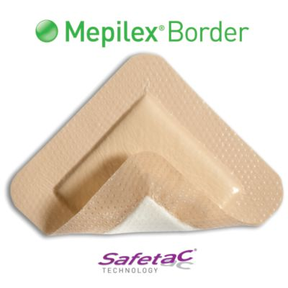
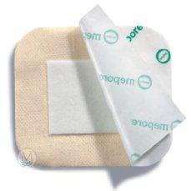
What are the characteristics of an ideal wound dressing?
Ability to conform to the wound
Easy to apply
Allow for swelling
Easy to remove
Minimise pain on removal

Slide 14
Dressings Used
Wound dressing | Proportion of total use
Mepilex | 49.3%
Tegaderm | 21.5%
Mepore | 0.4%
Opsite | 26.0%
Aquacel | 2.8%

Slide 15
Who should assess the wound and prescribe appropriate dressings?
4 respondents - nursing staff
2 respondents - doctor or surgeon.
3 respondents - doctor/surgeon or a member of the nursing staff.
3 respondents did not provide a response to this question.

Slide 16
Choice of dressing during first dressing change
5 respondents - same dressing or a different dressing could be applied.
4 respondents - same dressing would be applied.
1 respondent - different dressing would be applied.
2 respondents did not provide a response to this question.

Slide 17
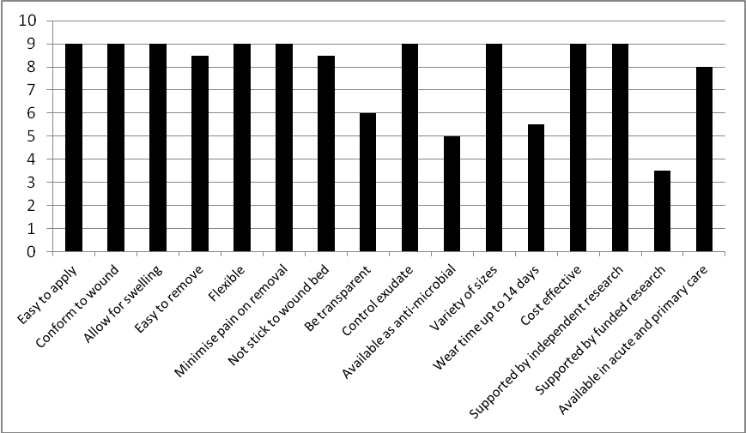
Summary of Scores

Slide 18
Conclusions from Delphi
The choice of post-operative wound dressing was the most important factor in the prevention of wound blister formation
Nursing staff should be the first to assess a wound post-operatively and to choose the appropriate wound dressing
The wound dressing should be left intact for as long as possible.
An ideal wound dressing to prevent wound blister formation should: conform to the wound, be easy to apply, allow for swelling, be easy to remove and minimise pain on removal

Slide 19
Full Results
Ousey, K., Gillibrand, W., Stephenson, J. Achieving international consensus for the prevention of orthopaedic wound blistering: results of a Delphi survey. International Wound Journal 2012; doi: 10.1111/j. 1742-481X.2012.00965x

Slide 20
References
Gupta SK, Lee S, Moseley L G (2002) Postoperative wound blistering: is there a link with dressing usage? Journal of Wound Care 11(7): 271–73
Polatsch DB, Baskies MA, et al (2004) Tape blisters that develop after hip fracture surgery: a retrospective series and a review of the literature. American Journal of Orthopaedics 33(9): 452–6
Jester, R., Russell, L., Fell,S. et al. A one hospital study of the effect of wound dressings and other related factors on skin blistering following total hip and knee arthroplasty. J Orthopaedic Nurs 2000; 4: 2, 71-77
Tustanowski J (2009) Effect of dressing choice on outcomes after hip and knee arthroplasty: a literature review. Journal of Wound Care, 18, 11, 449-458

